Slide 1
Factory Design Pattern
(Factory Method Pattern)
& Abstract Factory Design Pattern
Creational Design Pattern
Page 147

Slide 2
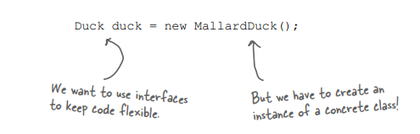
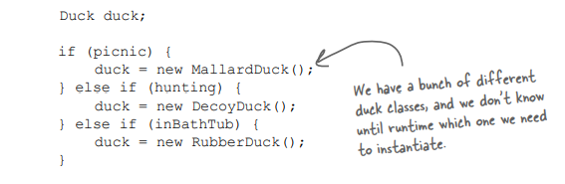
When you see “new”, think “concrete”.
Design Concern
Tying your code to a concrete class can make it more fragile and less flexible
When we have multiple concrete classes, we often write like this,
When you see code like this, you know that when it comes time for changes or extensions, you’ll have to reopen this code and examine what needs to be added (or deleted). Often this kind of code ends up in several parts of the application making maintenance and updates more difficult and error-prone.

Slide 3
Implementing via interface
When new logic needs to be added, we just simply add a new implementation in the form of a class implementing an interface. The application of polymorphism.
Implementing via concrete classes
We have to write a new class implementing the logics and then modify/change/replace existing codebases’ fragments

Slide 4
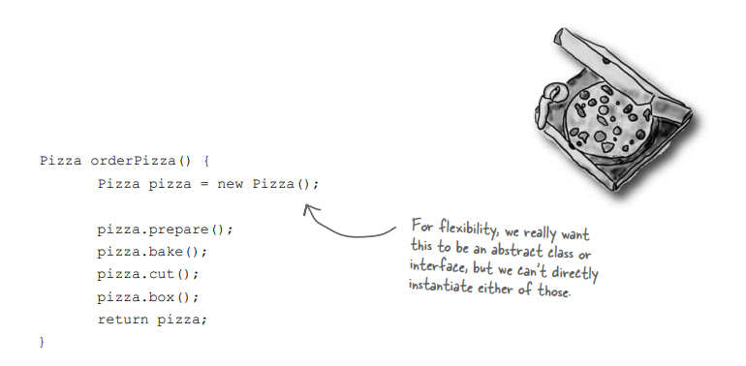
A Pizza Shop Problem !
Challenge: We need to model different types of pizzas
Need a superclass.

Slide 5
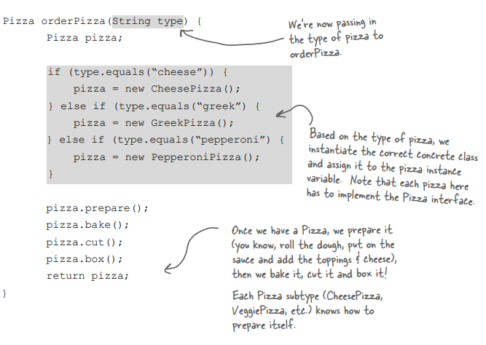
A possible solution to modeling muti type pizza problem

Slide 6
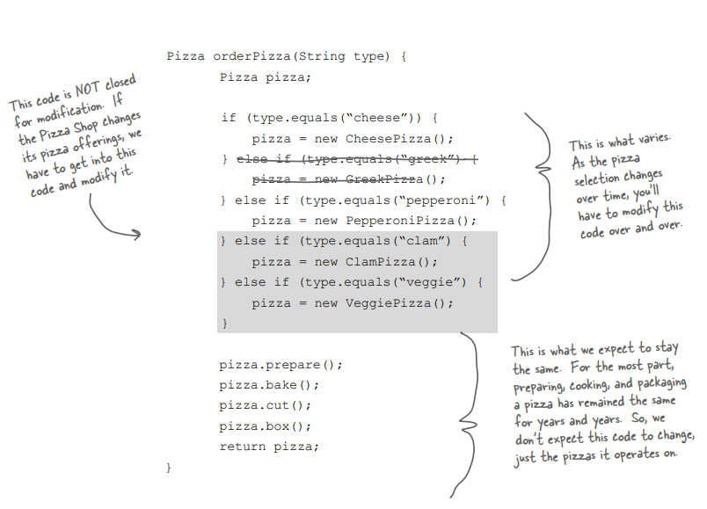
Closed for modification == Some portion of the code will never need to be modified.
Varying
Open Close Principle:
I will just add new codes but will not modify/replace/change existing codebase
Staying same

Slide 7
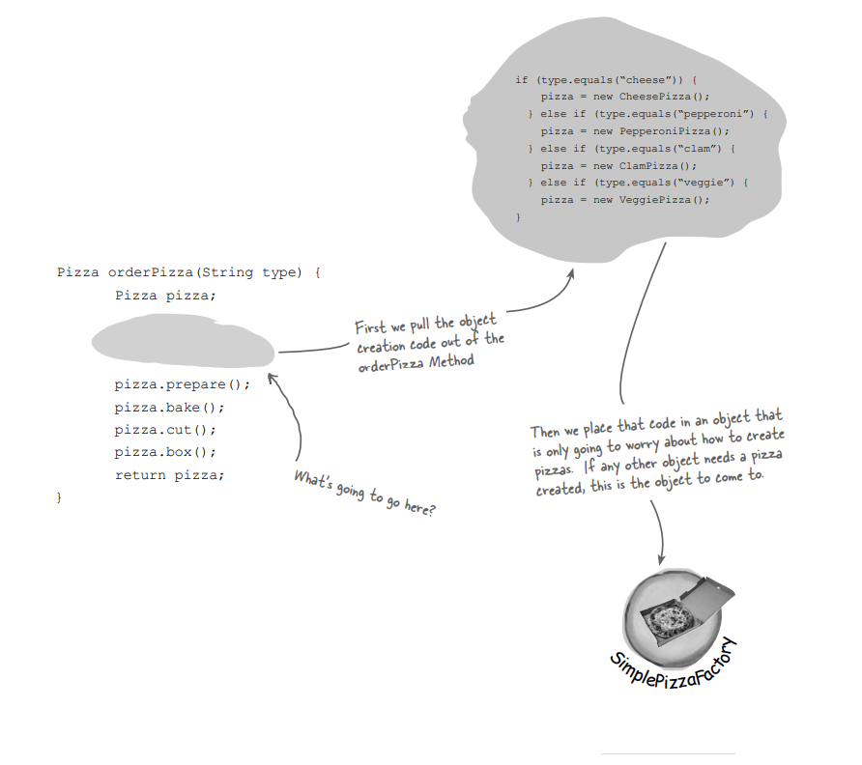
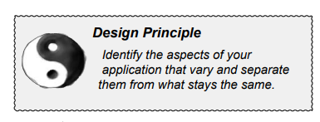
Encapsulating object creation
An object to encapsulate this creation logic
A Factory to handle the details of object creation.

Slide 8
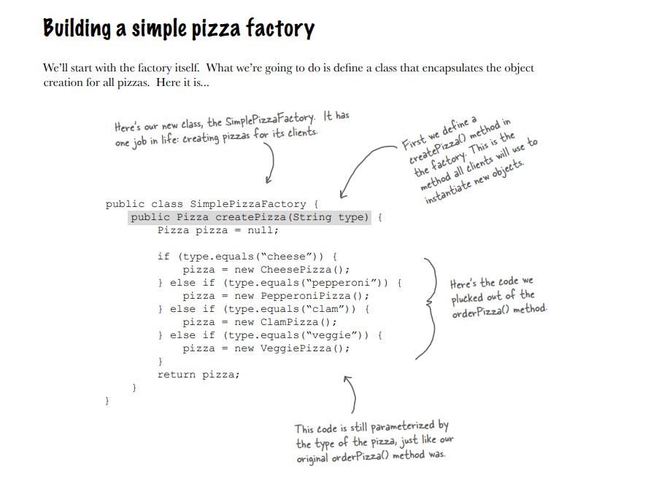
A class to encapsulate the object creation logic.

Slide 9
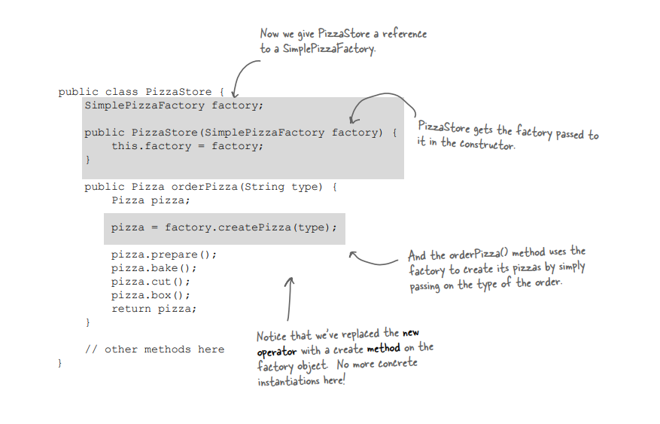
Reworking the PizzaStore class
Avoided the use of new operator.

Slide 10
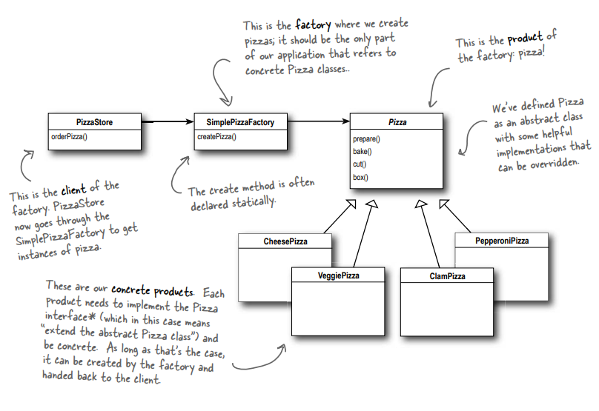
Simple Factory
(Not a design pattern but a programming paradigm)

Slide 11
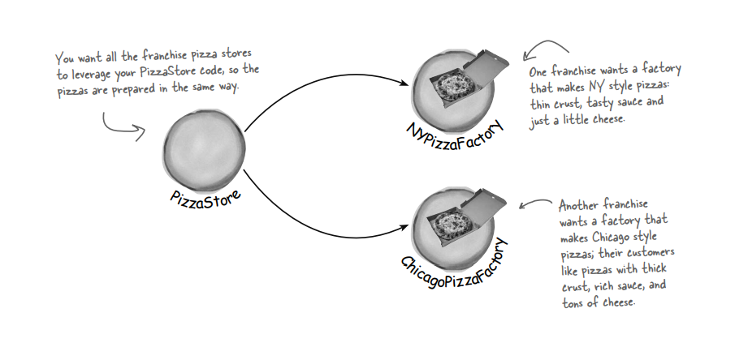
Franchising the pizza store !

Slide 12
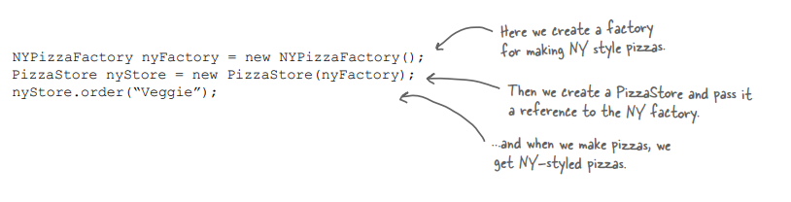
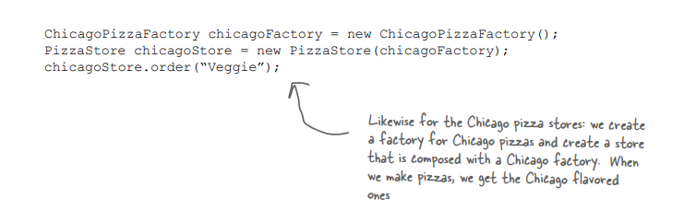
PizzaStore
NyPizzaFactory
ChicagoPizzaFactory

Slide 13
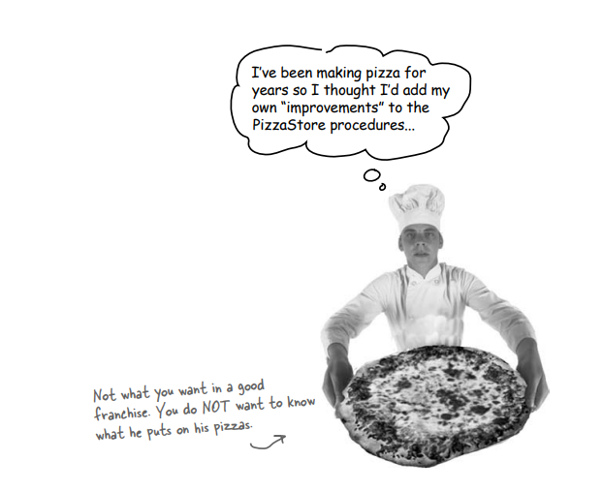
How about adding more personal tastes !!!

Slide 14
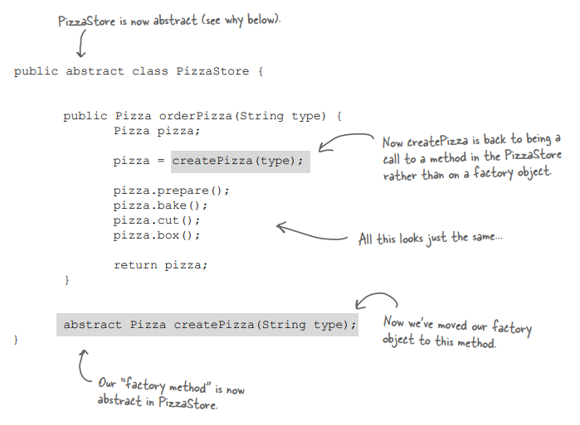
A framework for the pizza store
There is a way to localize all the pizza making activities to the PizzaStore class, and yet give the franchises freedom to have their own regional style
PizzaStore
NyPizzaFactory
ChicagoPizzaFactory

Slide 15
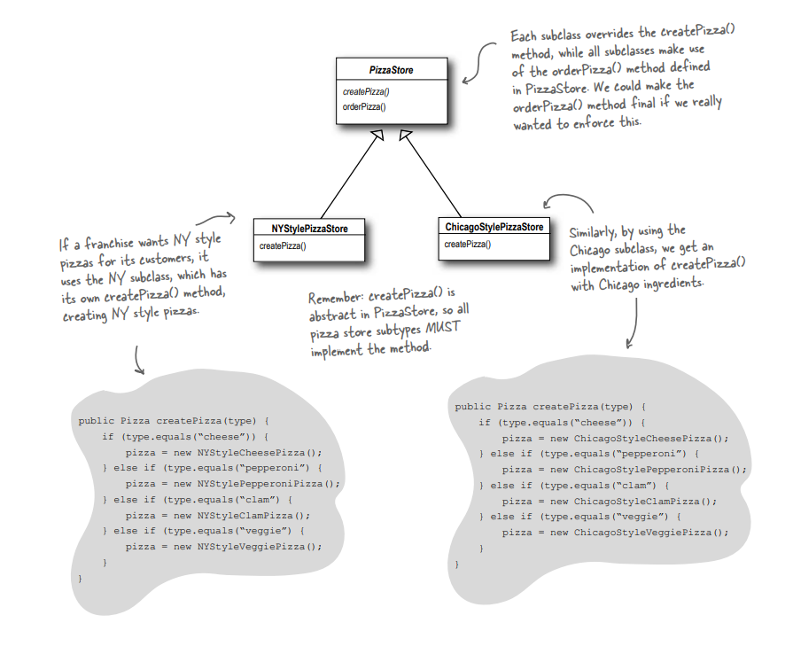
Concrete classes are omitted

Slide 16
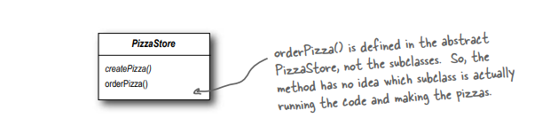
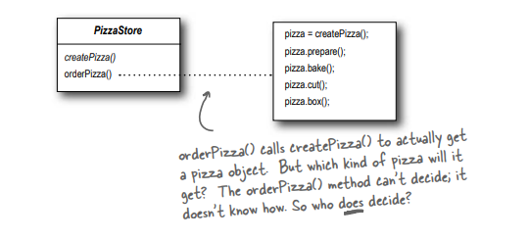
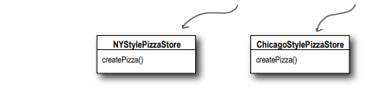
How to subclasses decide ?

Slide 17
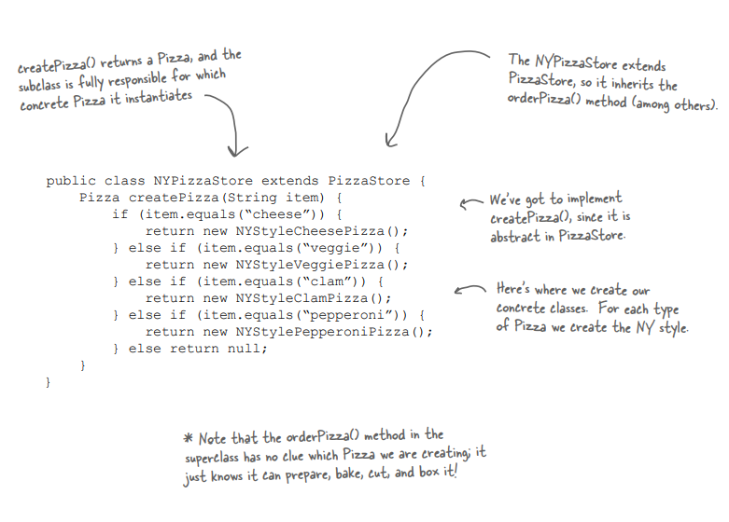
Lets make a PizzaStore

Slide 18
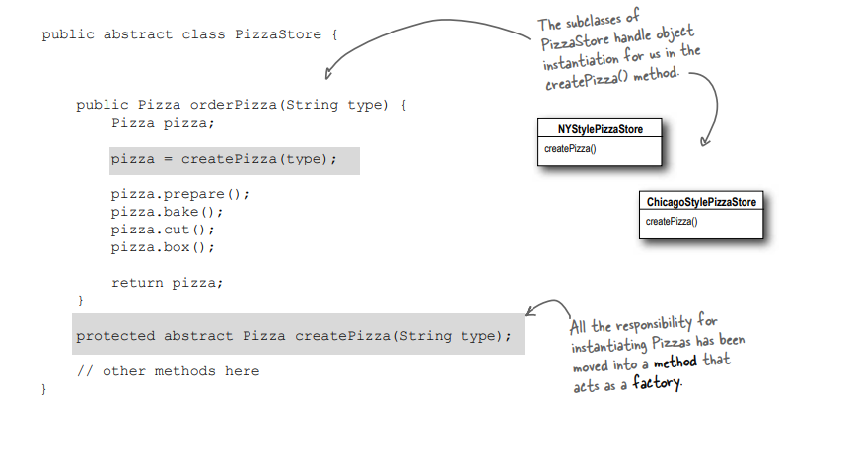
Declaring a factory method

Slide 19
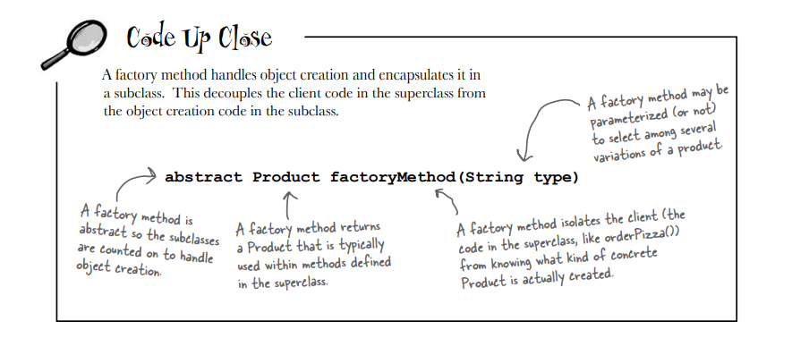
Sketch of Factory Design Pattern

Slide 20

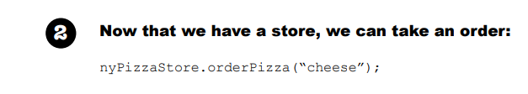
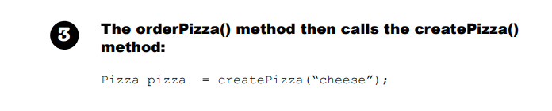
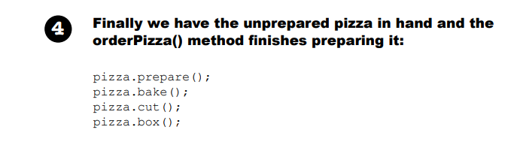
Flow of the code

Slide 21
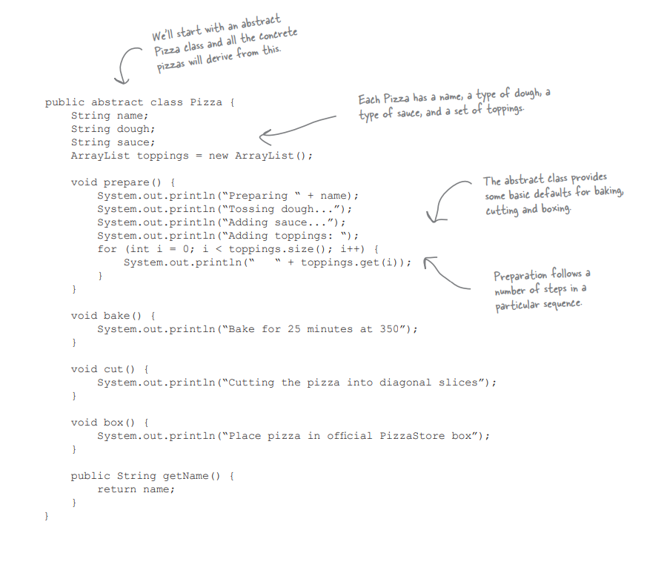
Completing the code-1

Slide 22
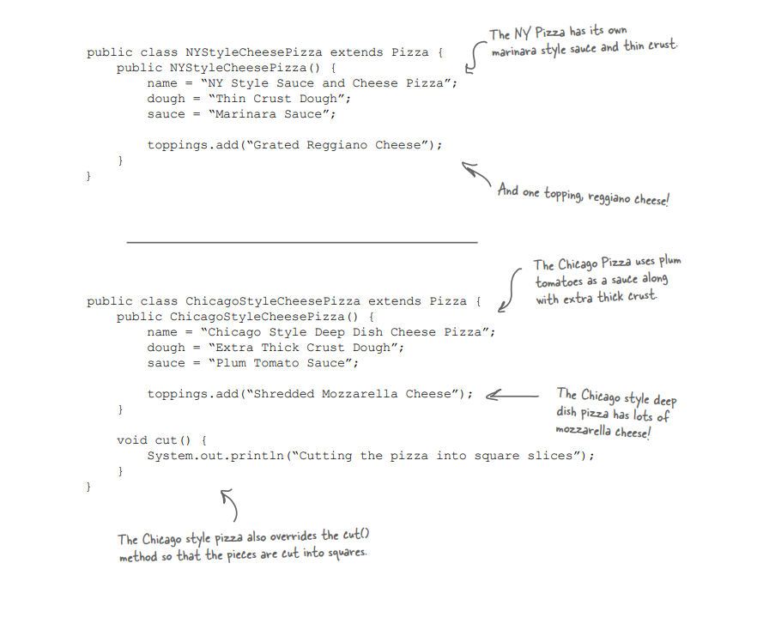
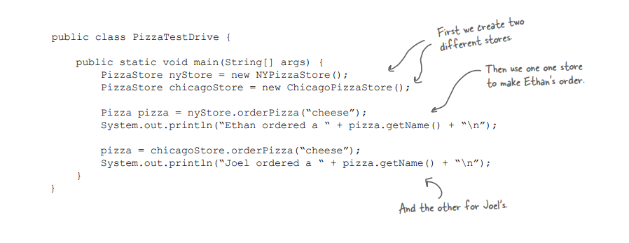
Subclass implementations
Main Class

Slide 23
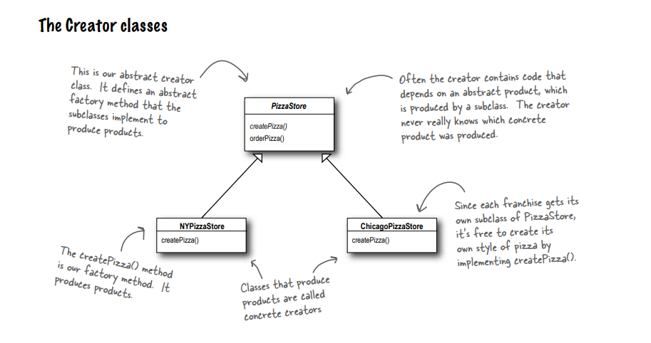
Factory Method Pattern Class Design Part 1

Slide 24
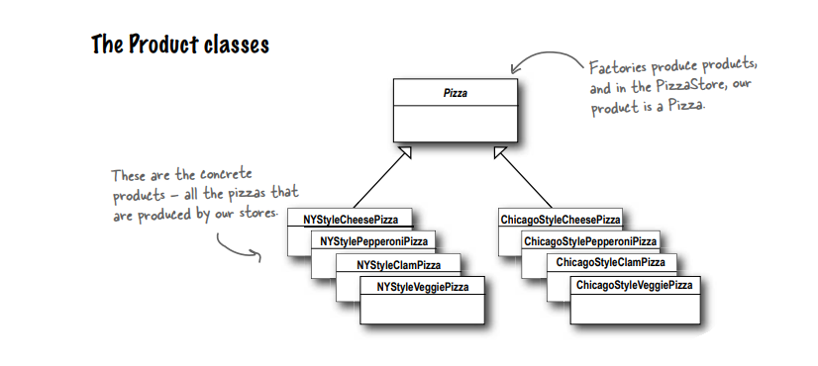
Factory Method Pattern Class Design Part 2

Slide 25
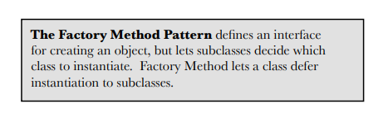
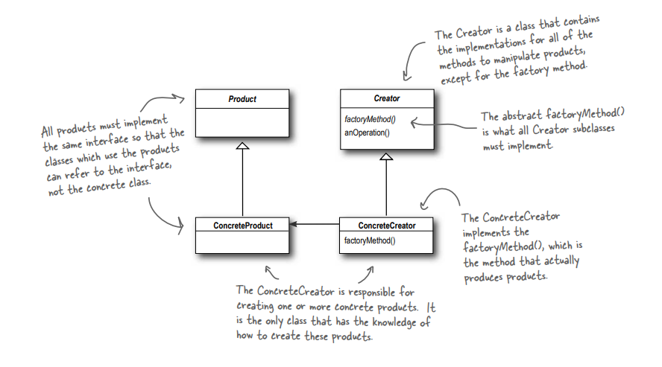
Factory Design Pattern summarized
Product Abstraction
Factory Abstraction
Product
Factory

Slide 26
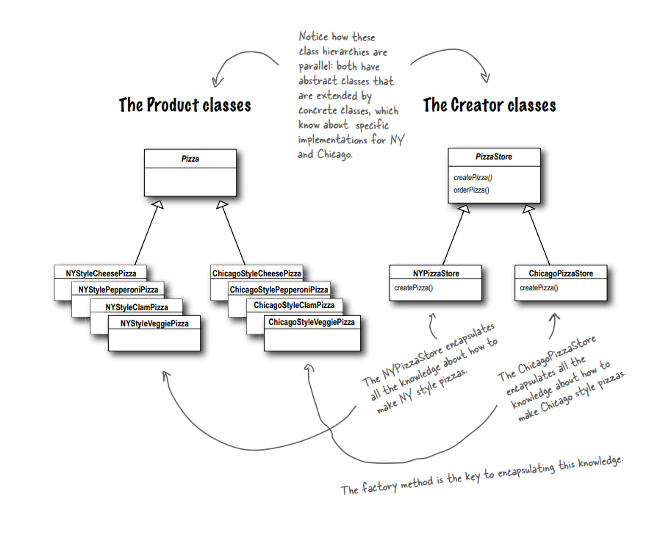
Parallel Representation of Factory Design Pattern for the example

Slide 27
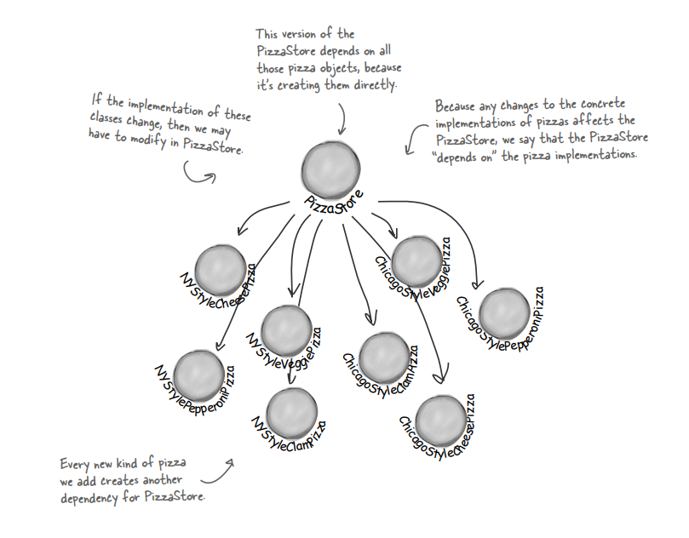
1.
Looking at object dependencies
2.
3.

Slide 28
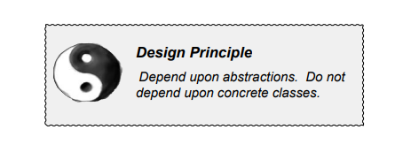
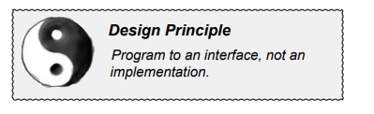
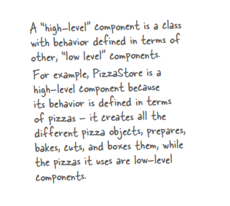
Similar to
Difference.
It suggests that our high-level components should not depend on our low-level components; rather, they should both depend on abstractions

Slide 29
High level depending on lower level concrete classes

Slide 30
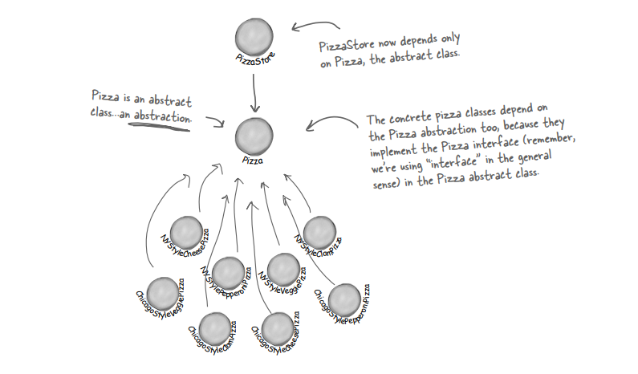
Higher class
Applying the Dependency inversion principle
abstraction
Lower classes

Slide 31
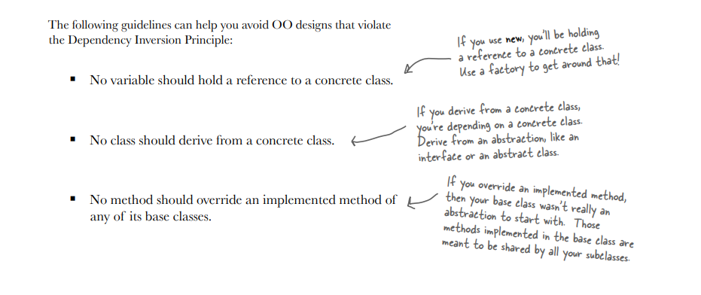
A Few guidelines to follow the principle

Slide 32
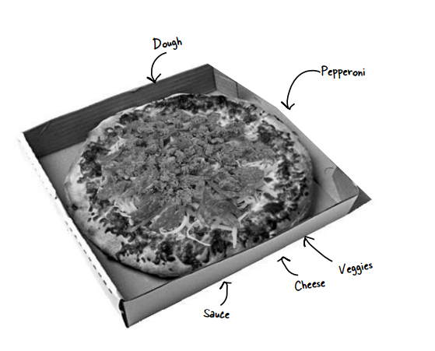
Now, let us add different types of ingredients to make pizzas

Slide 33
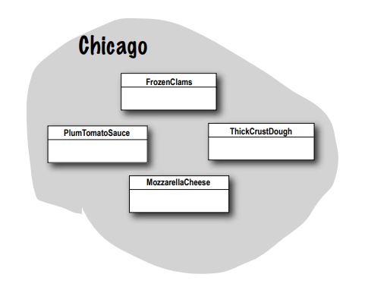
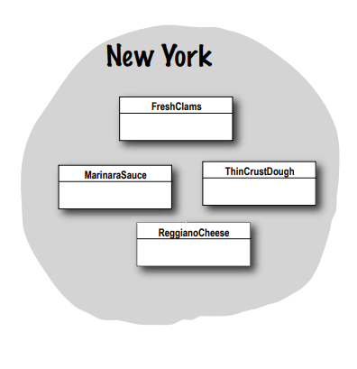
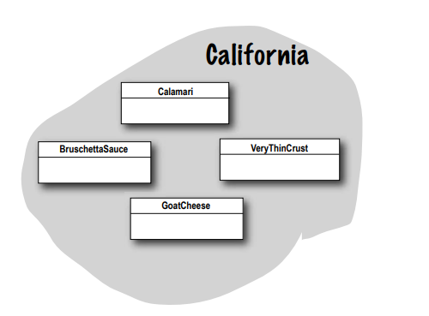
Families of ingredients
Each family consists of a type of dough, a type of sauce, a type of cheese, and a seafood topping (along with a few more we haven’t shown, like veggies and spices).
All Objectville’s Pizzas are made from the same components, but each region has a different implementation of those components.

Slide 34
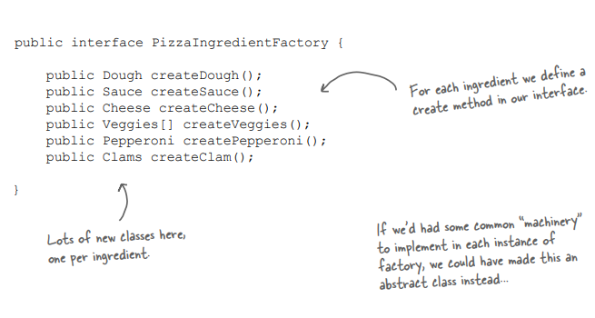
Building the ingredient factories
Factory interface and Element Interface

Slide 35
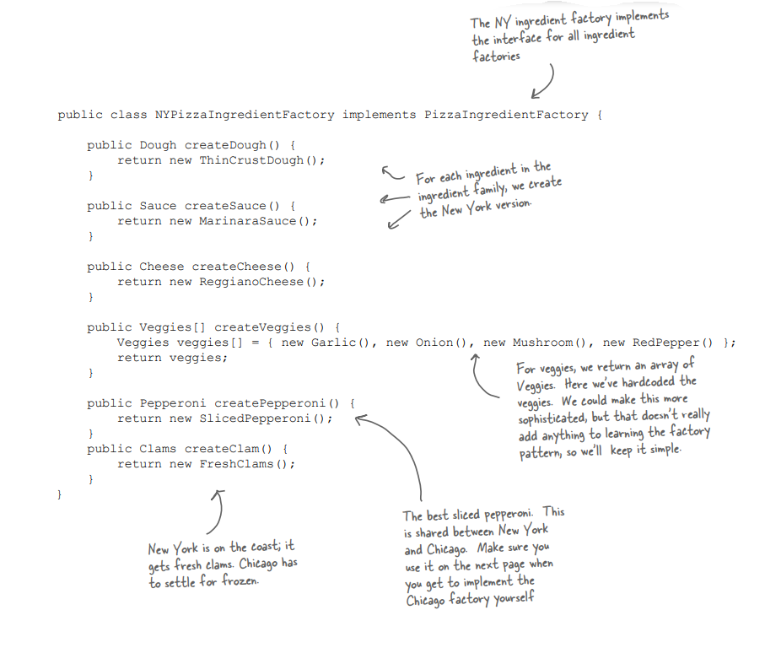
A class implementing the factory interface

Slide 36
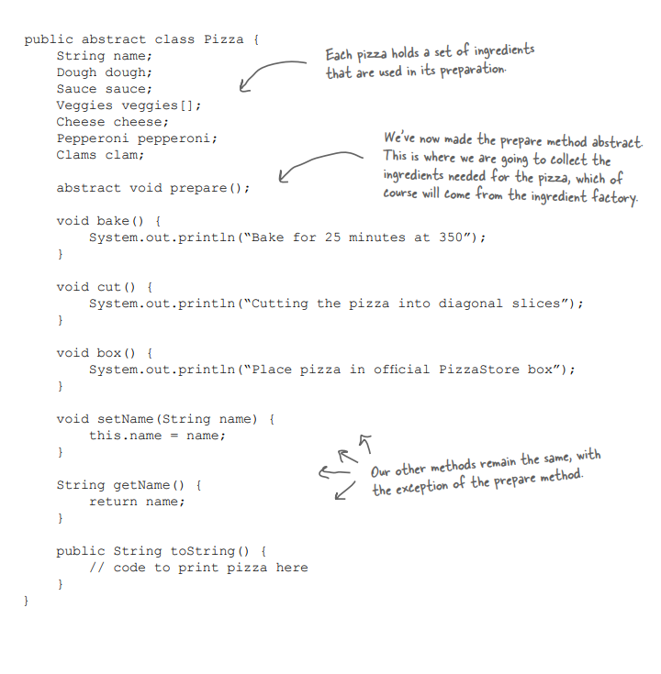
New Definition of Pizza Class
Another factory method to be implemented

Slide 37
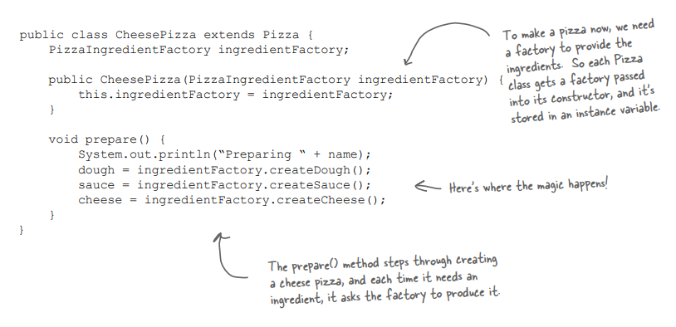
An implementation of Pizza
factory
Factory method implementation

Slide 38
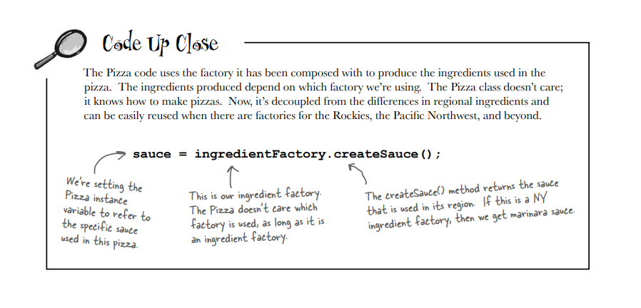

Slide 39
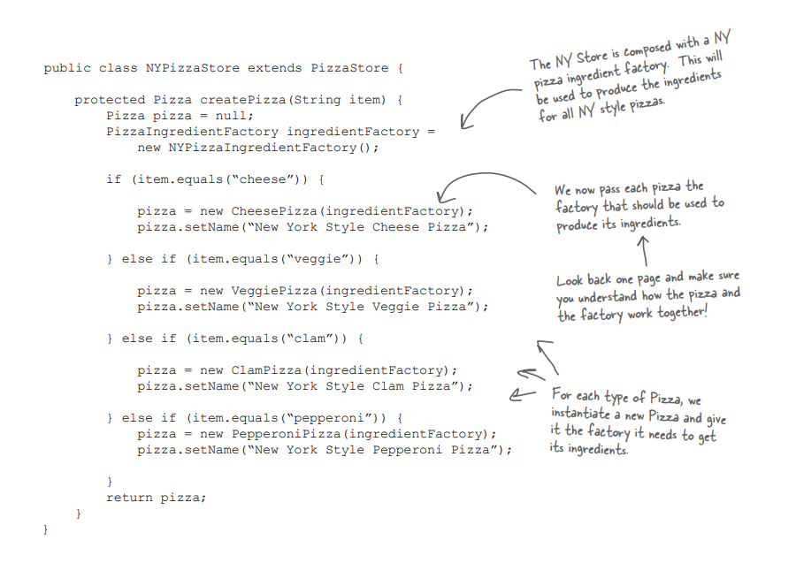
Revisiting the pizza store

Slide 40
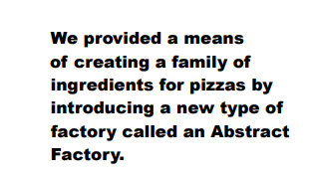



Slide 41




Behind the scenes

Slide 42


Slide 43


CheesePizza,
VeggiePizza,
ClamPizza, …..
Dashed line = implements
Black line = uses

Slide 44


Dough dough
Sauce sauce
Cheese cheese
PizzaIngredientFactory ingredientFactory

Slide 45

Comparing Factory Method and Abstract Factory Method
The Factory Design Pattern is a creational pattern that provides an interface for creating objects of a certain class without specifying the exact class itself.
In this pattern, you have a single factory class with a method responsible for creating objects based on certain parameters or conditions. It is useful when you have a common base class/interface, but there are multiple derived classes, and the exact class to be instantiated is determined at runtime
Book page 198

Slide 46

The Abstract Factory Design Pattern is also a creational pattern but provides an interface for creating families of related or dependent objects without specifying their concrete classes. It is designed to work with multiple factory methods, each responsible for creating objects of a particular type or family.
This pattern is useful when your system has multiple families of related objects, and you want to ensure that the objects created within a family are compatible with each other.

Slide 47
Summary
OO Principle:
Depend on abstractions. Do not depend on concrete classes.
Factory Method - Define an interface for creating an object, but let subclasses decide which class to instantiate. Factory Method lets a class defer instantiation to the subclasses.
Abstract Factory - Provide an interface for creating families of related or dependent objects without
specifying their concrete classes.

